Slide 1



Employee Attrition Prediction
Salah Zaman Cohort: June 2024 September 09, 2024

Slide 2
About the Dataset
The source of the dataset would be Upright Education.
How many employees it covers: 2,381
Time span of the data: 2010 – 2024
Key features considered: Salary, Age, Total Business Value, Quarterly Ratings and Designation(s).

Slide 3
Purpose
This analysis aims to predict employee attrition by examining factors such as age, gender, salary, education, location (state), job designation, and performance metrics. The insights gained will assist HR in identifying and addressing potential attrition risks.

Slide 4
Method
I primarily used Python, leveraging libraries such as pandas, numpy, scikit-learn, datetime, matplotlib, and ARIMA for forecasting, along with Tableau for visualization.
I will focus on the major factors that significantly contribute to employee attrition.
Additionally, I generated a forecast using Python to help HR gain a clearer understanding of employee attrition trends.

Slide 5
Some of the basic things about the company and employee attrition would be

Slide 6
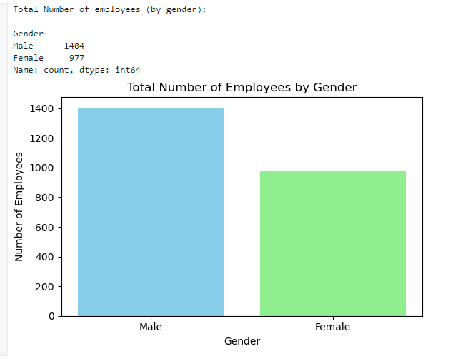

Slide 7
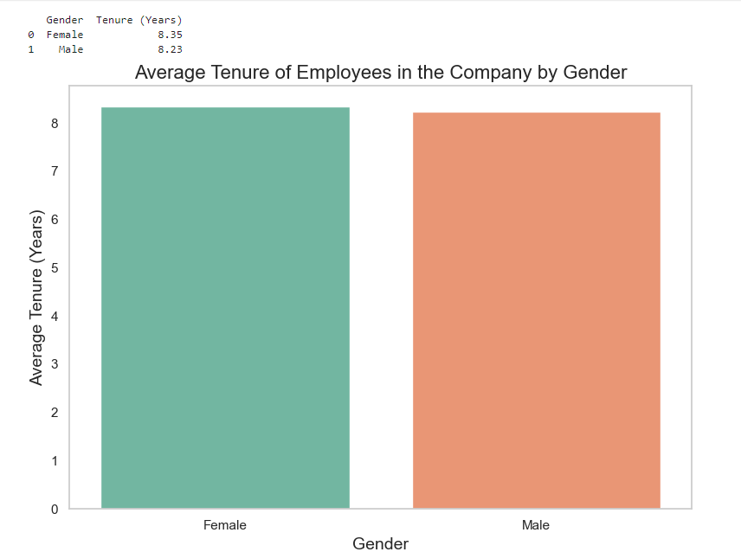

Slide 8
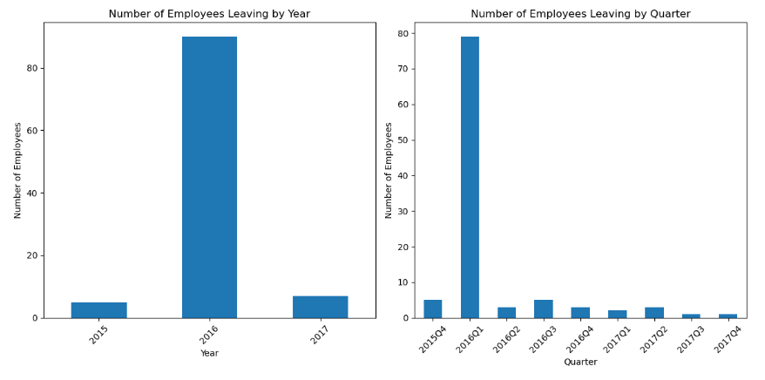

Slide 9
There are some factors which are more important than the others, that I believe effecting highly in employee attrition in the company such as

Slide 10
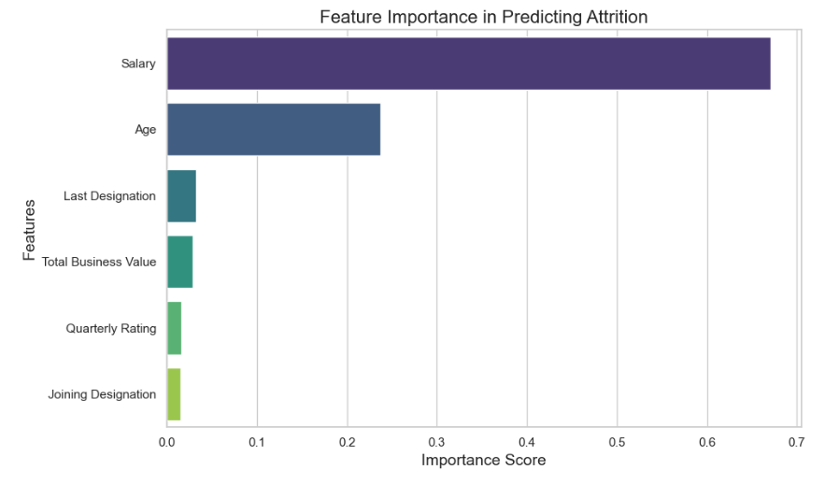

Slide 11
Now I will be talking about those factors in detail.

Slide 12
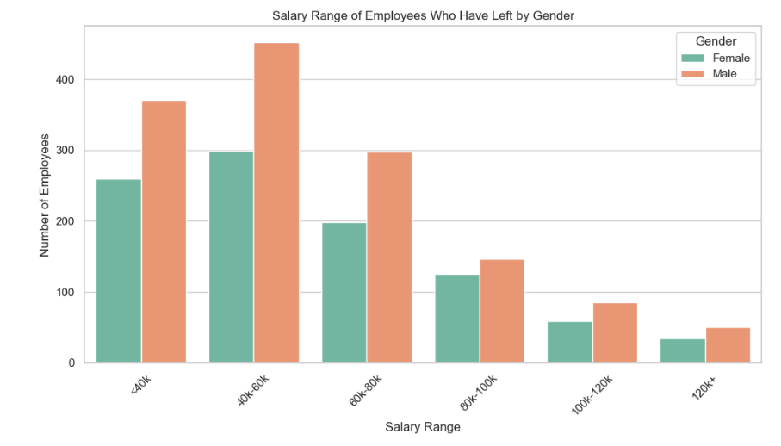

Slide 13
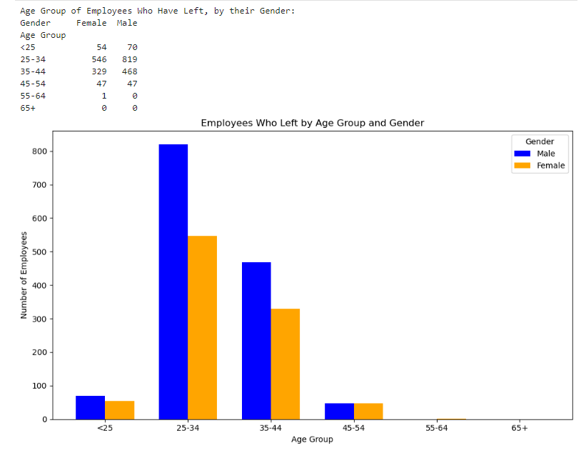

Slide 14
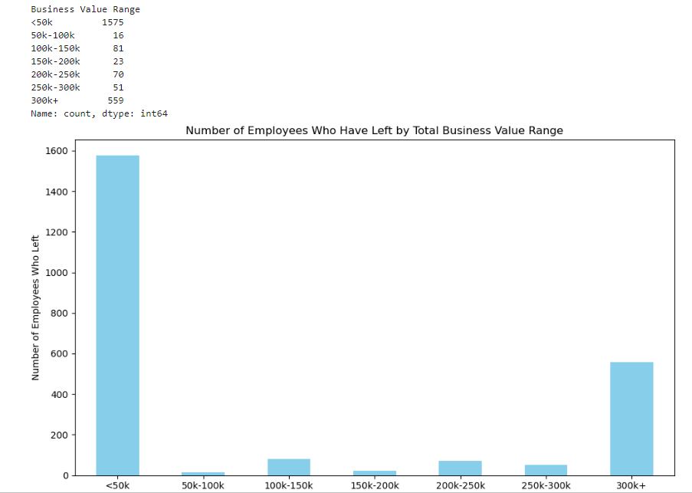

Slide 15
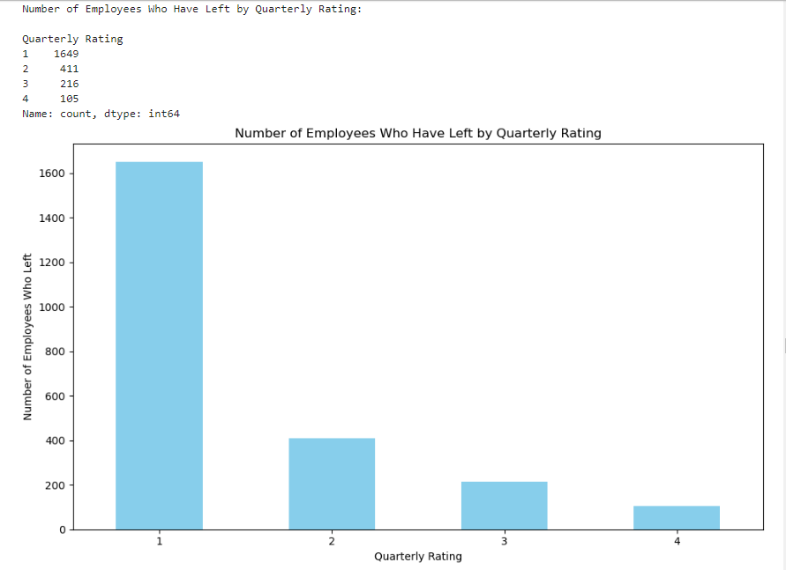

Slide 16
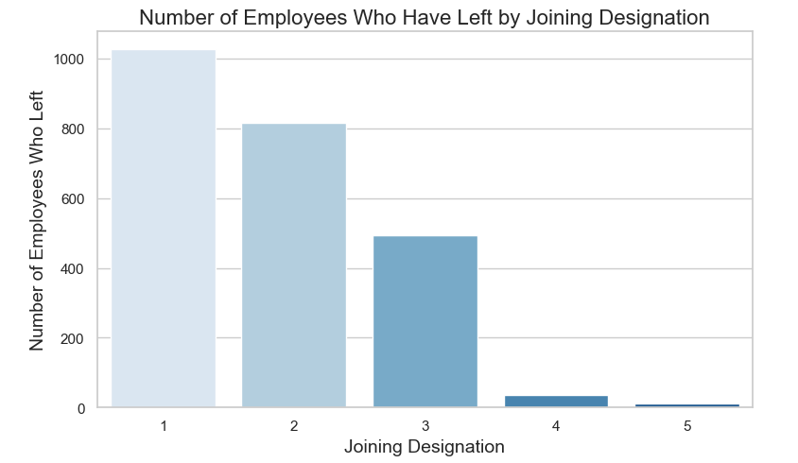

Slide 17
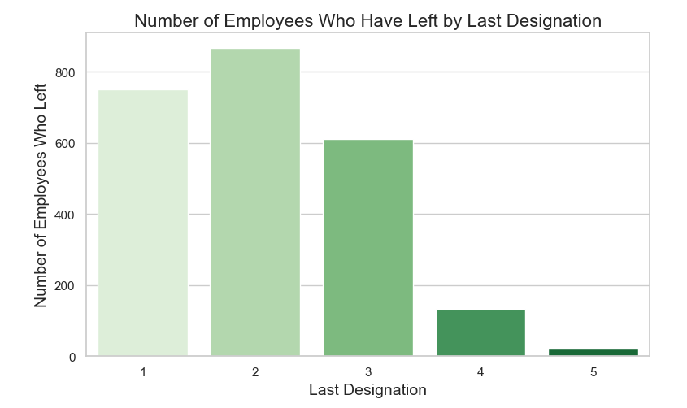

Slide 18
There are additional factors that HR can consider when assessing which employees may be at risk of leaving the company. While these factors may not be as significant as the primary ones, they can still play a role.

Slide 19
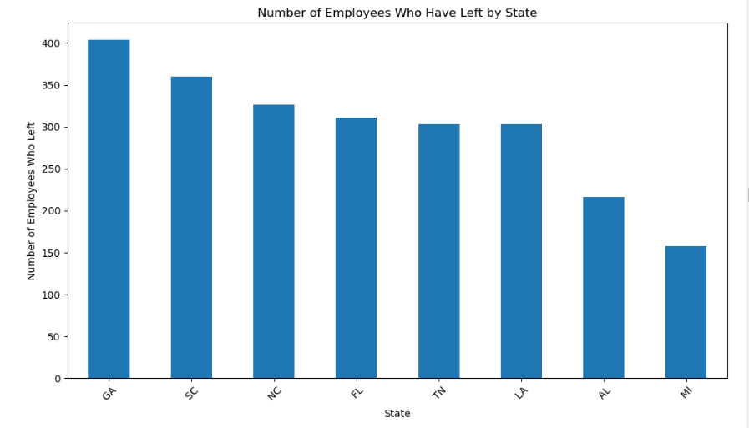

Slide 20
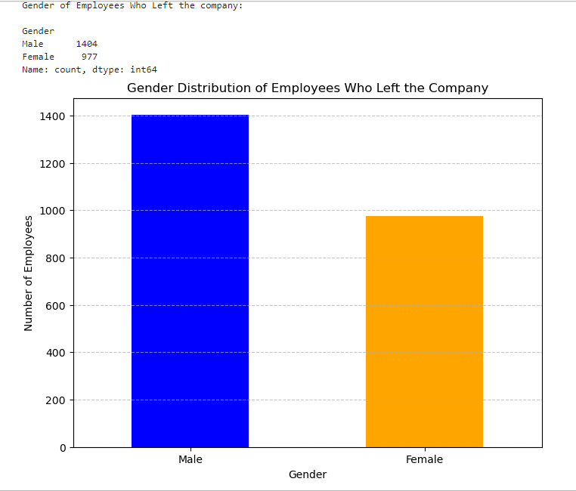

Slide 21
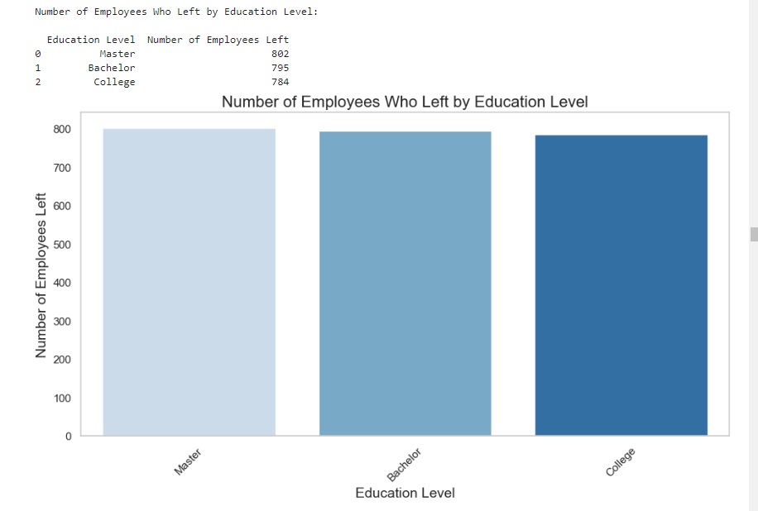

Slide 22
Here’s the Employee Attrition Forecast for the next 12 month.

Slide 23
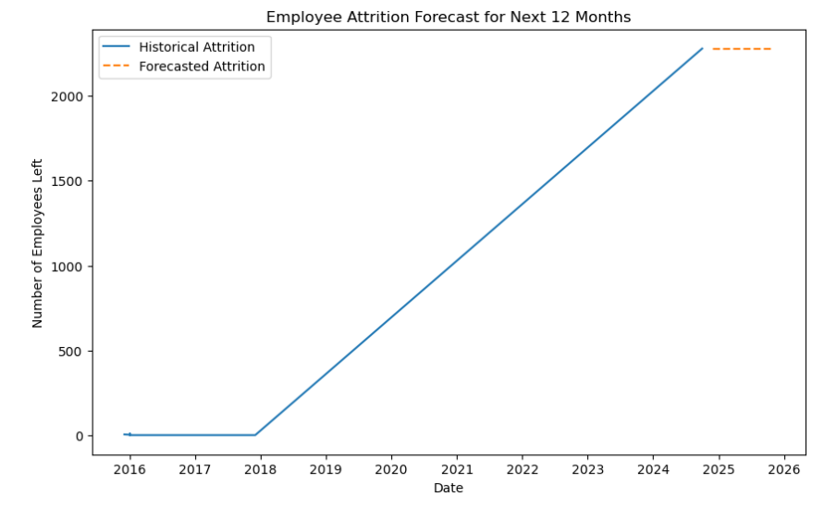

Slide 24
Conclusion
My final recommendation for the HR is to focus on the key factors that indicate which employees are at risk of leaving the company. By prioritizing these significant factors, HR can implement more effective retention strategies.
One crucial area to address is salary adjustments, particularly for employees who may be considering leaving due to compensation that is perceived as inadequate. Making timely salary increases can help retain these individuals.

Slide 25
Conclusion (cont.)
Additionally, HR should concentrate retention efforts on younger employees, as they may be more likely to seek new opportunities. It's also important to identify employees with lower performance ratings, such as those with lower designations or quarterly evaluations, particularly if they are still delivering significant business value. By supporting these employees through targeted development and engagement initiatives, HR can enhance retention and foster a more committed workforce.

Slide 26
Question(s) / Comments !!

